Slide 1

Team…. Thailand4.0

Slide 2
Introduction

Slide 3

Agenda
Our expectation
FI Upstream SAP
Pain point & Solution
Work process
Intern life

Slide 4

Expectation
Working
experience
Technical
skills
Hard & soft skill
Find myself
New friends

Slide 5



Financial Upstream SAP
Support
EMIT FI Upstream SAP
Upstream business
Notes:
Which each team responsible for support FI Upstream(non-EMIT) in different region. And we're in Thotsakan team.

Slide 6


Financial Upstream SAP
Scrumblers
Polaris
Supernova
Thotsakan
4 teams
Notes:
EMIT FI Upstream team separate to 4 teams, Thotsakan, Scrumblers, Supernova and Polaris.

Slide 7










Thotsakan
Scrumblers
Supernova
Polaris
IT Console
Users
Dispatcher
Notes:
(Animation) Users report problem/issue as a ticket and we have ticket dispatcher to monitor tickets and assign that ticket to team member for solving problem

Slide 8
Why tickets are important?
Notes:
Critical to business ---- example

Slide 9
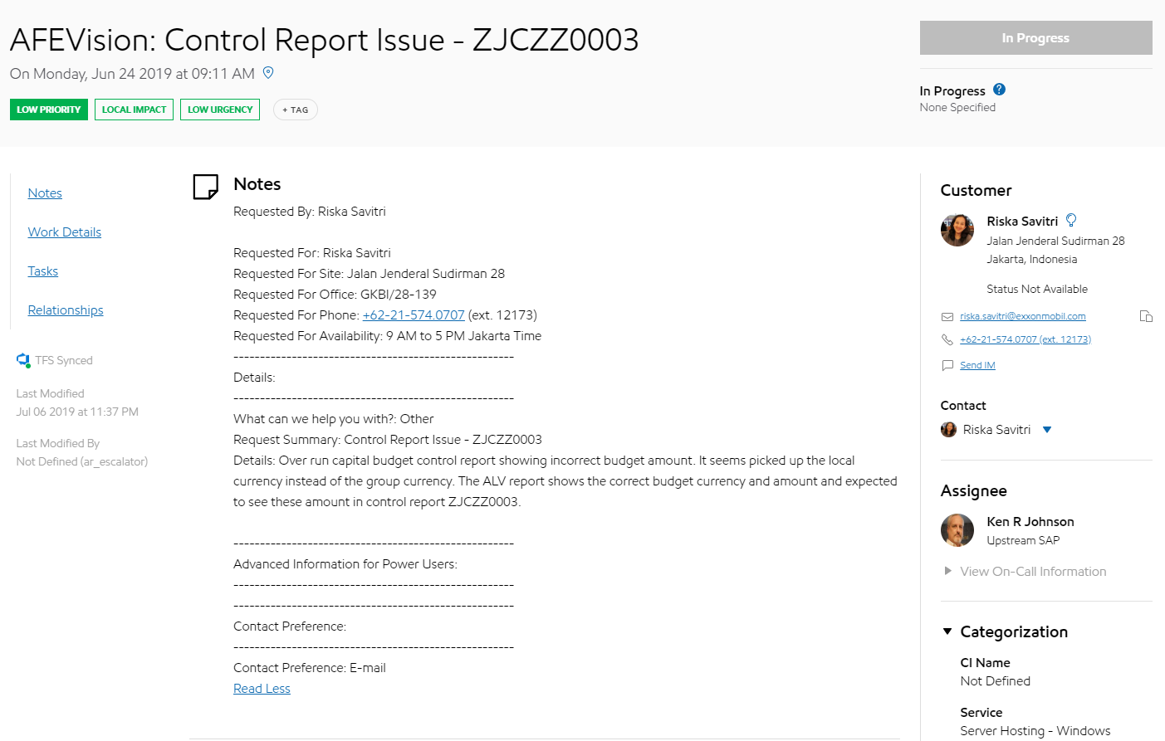
Ticket
Summary
Customer
Details
Notes:
tickets

Slide 10
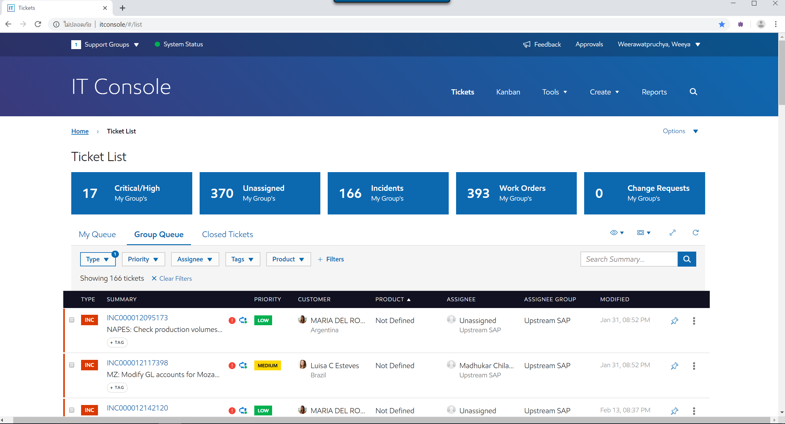

IT Console
Users

Slide 11




Classify & Assign tickets
?
FI Upstream SAP
4 sub-teams
?
Thotsakan
Scrumblers
Supernova
Polaris
Notes:
It console where we display tickets from ITSM
It console ไม่ตอบโจทย์

Slide 12
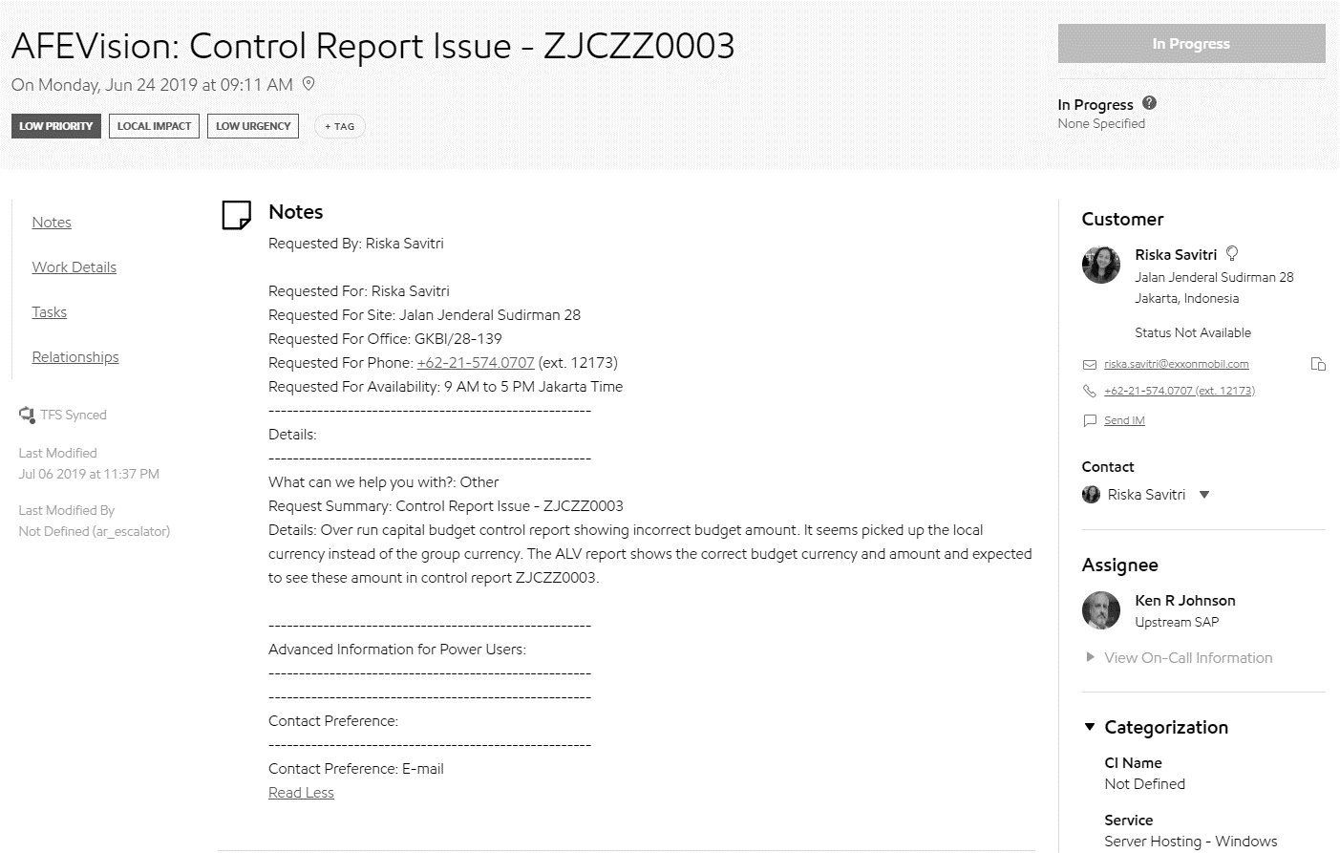
Classify & Assign tickets
3. Customer region?
2. Keyword?
IPES & NAPES?
NAPES?
Company code → Impact country
Impact country?
Pain point
1. Assign?
DIspatcher
Notes:
If some of you have a question why customer won’t tell definitely which team should responsible for that problem
Because customer also don’t know too. They just monitor and report problem.

Slide 13

Solution
Thotsakan
Supernova/Polaris
Ticket
Scrumblers
Classification system
Global
Notes:
solution

Slide 14




Work process
Agile
methodology
Scrum
framework

Slide 15
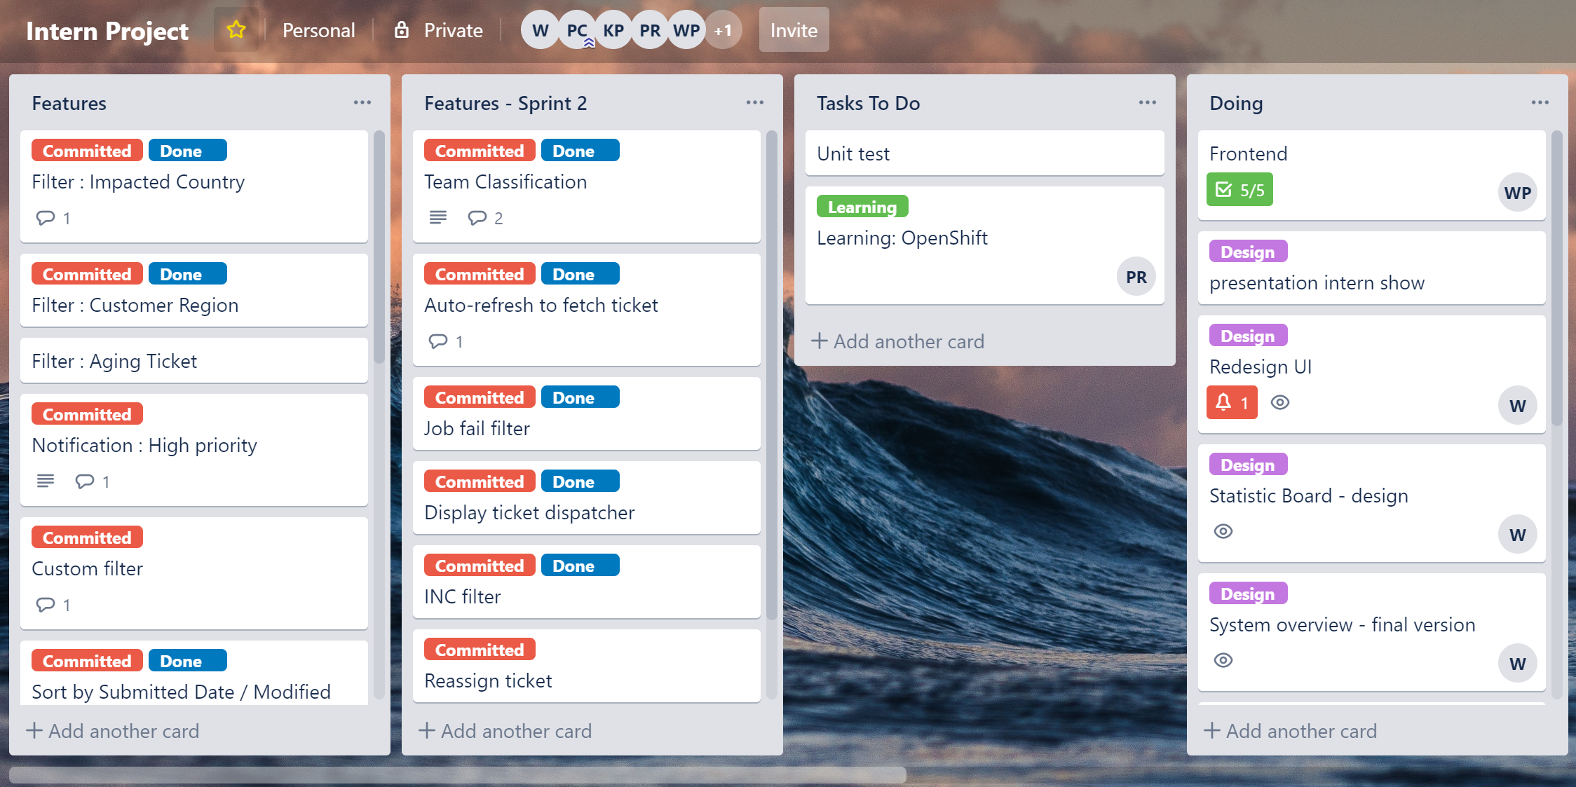
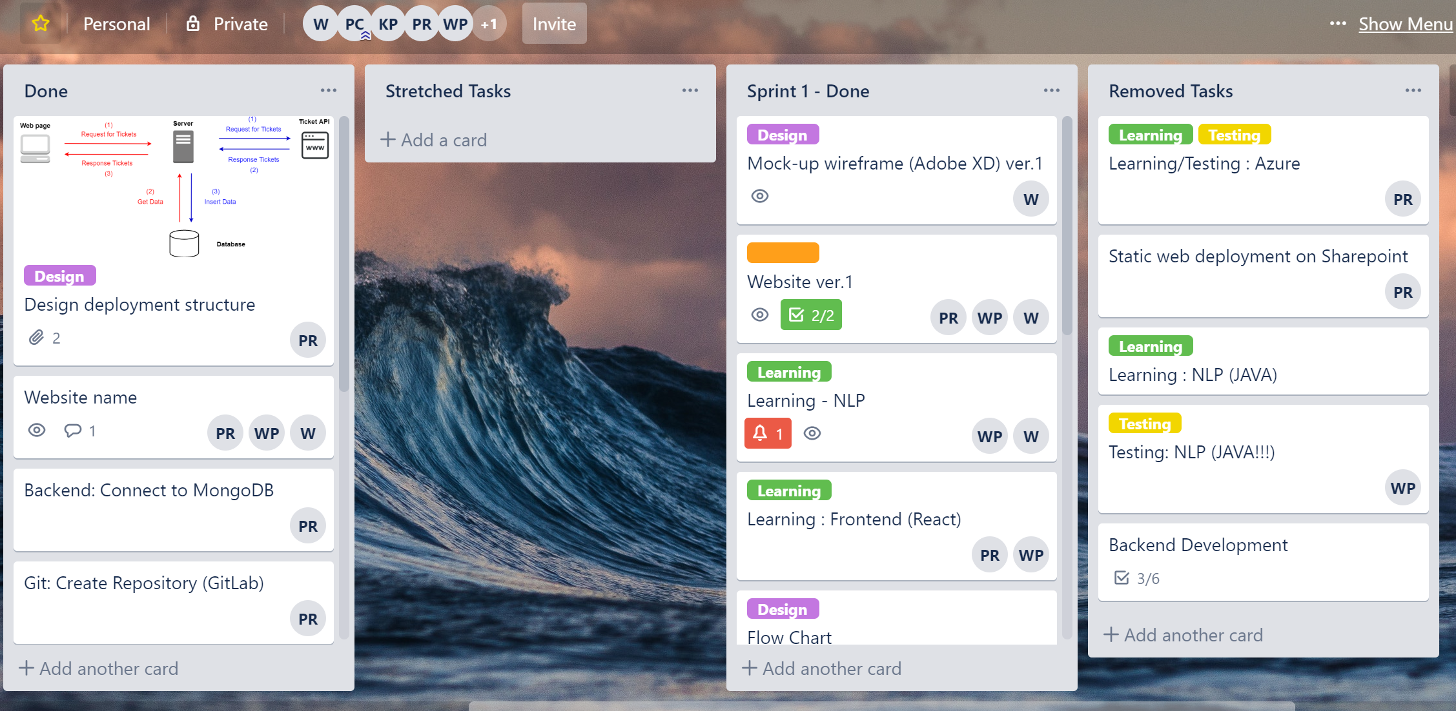

Slide 16
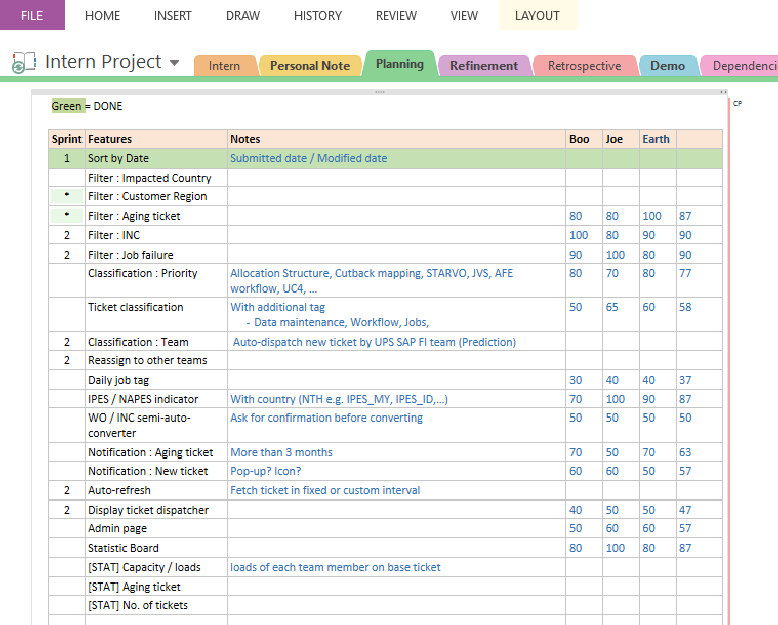
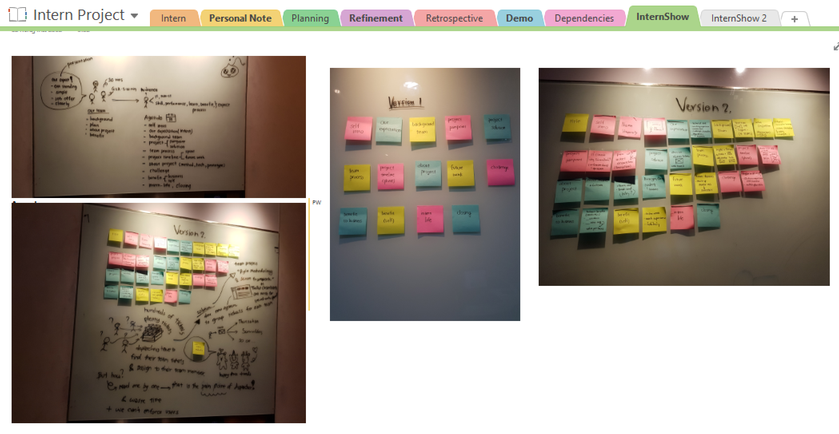

Slide 17
Timeline
Phase 1
Phase 2
2months
4months

Slide 18
Phase 1 (2 months)
Sprint 1
Sprint 2
Sprint 3
Gather requirements
Learning development tools
Design wireframe and UI version 1
Design system overview version 1
Make website version 1
Rewrite some logics
Refactor code (optimize and clean code)
Prepare for Interns show presentation
Redesign UI (version 2)
Redesign system overview
Make website version 2
Use version control (GitLab)

Slide 19
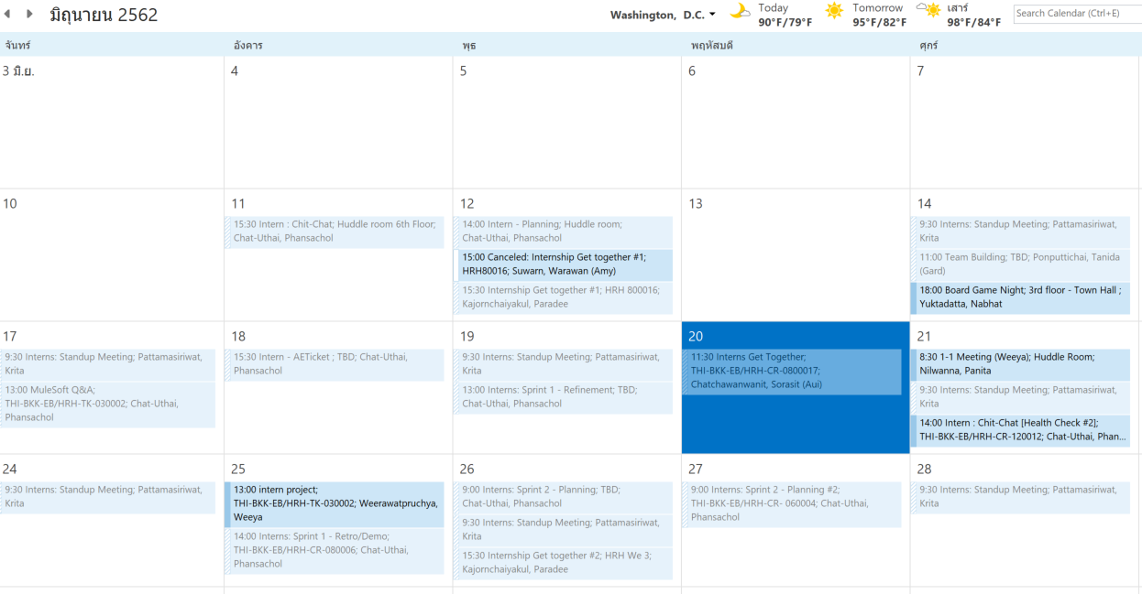

Slide 20
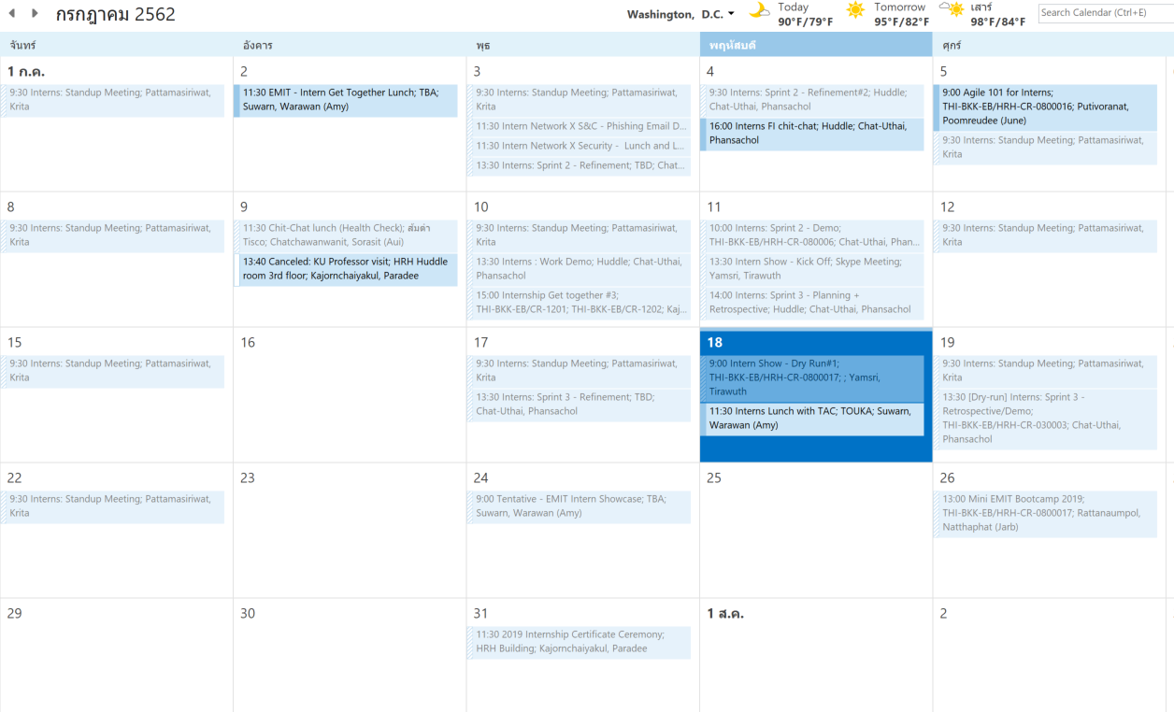

Slide 21
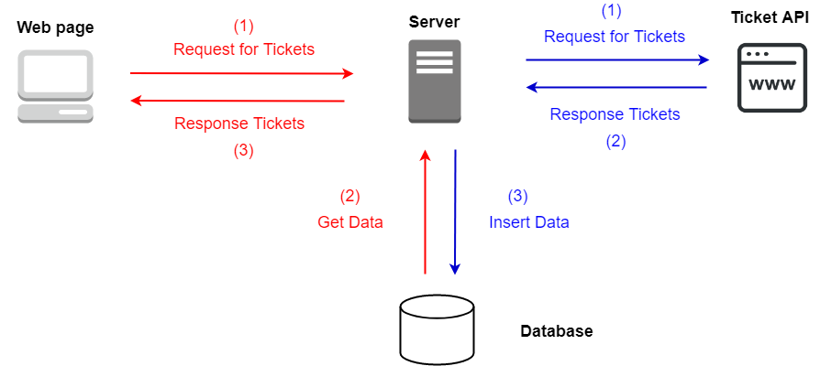
System overview

Slide 22


Technologies – Front End
React

Slide 23



Technologies – Backend
Python

Slide 24
demo

Slide 25
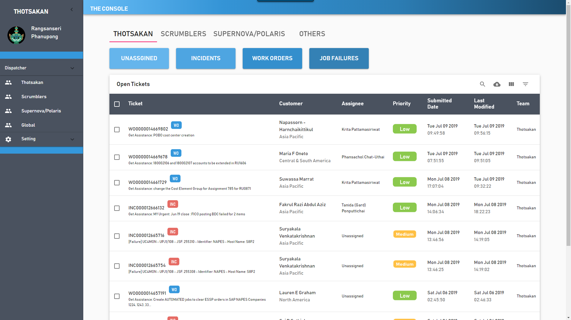
Home page

Slide 26
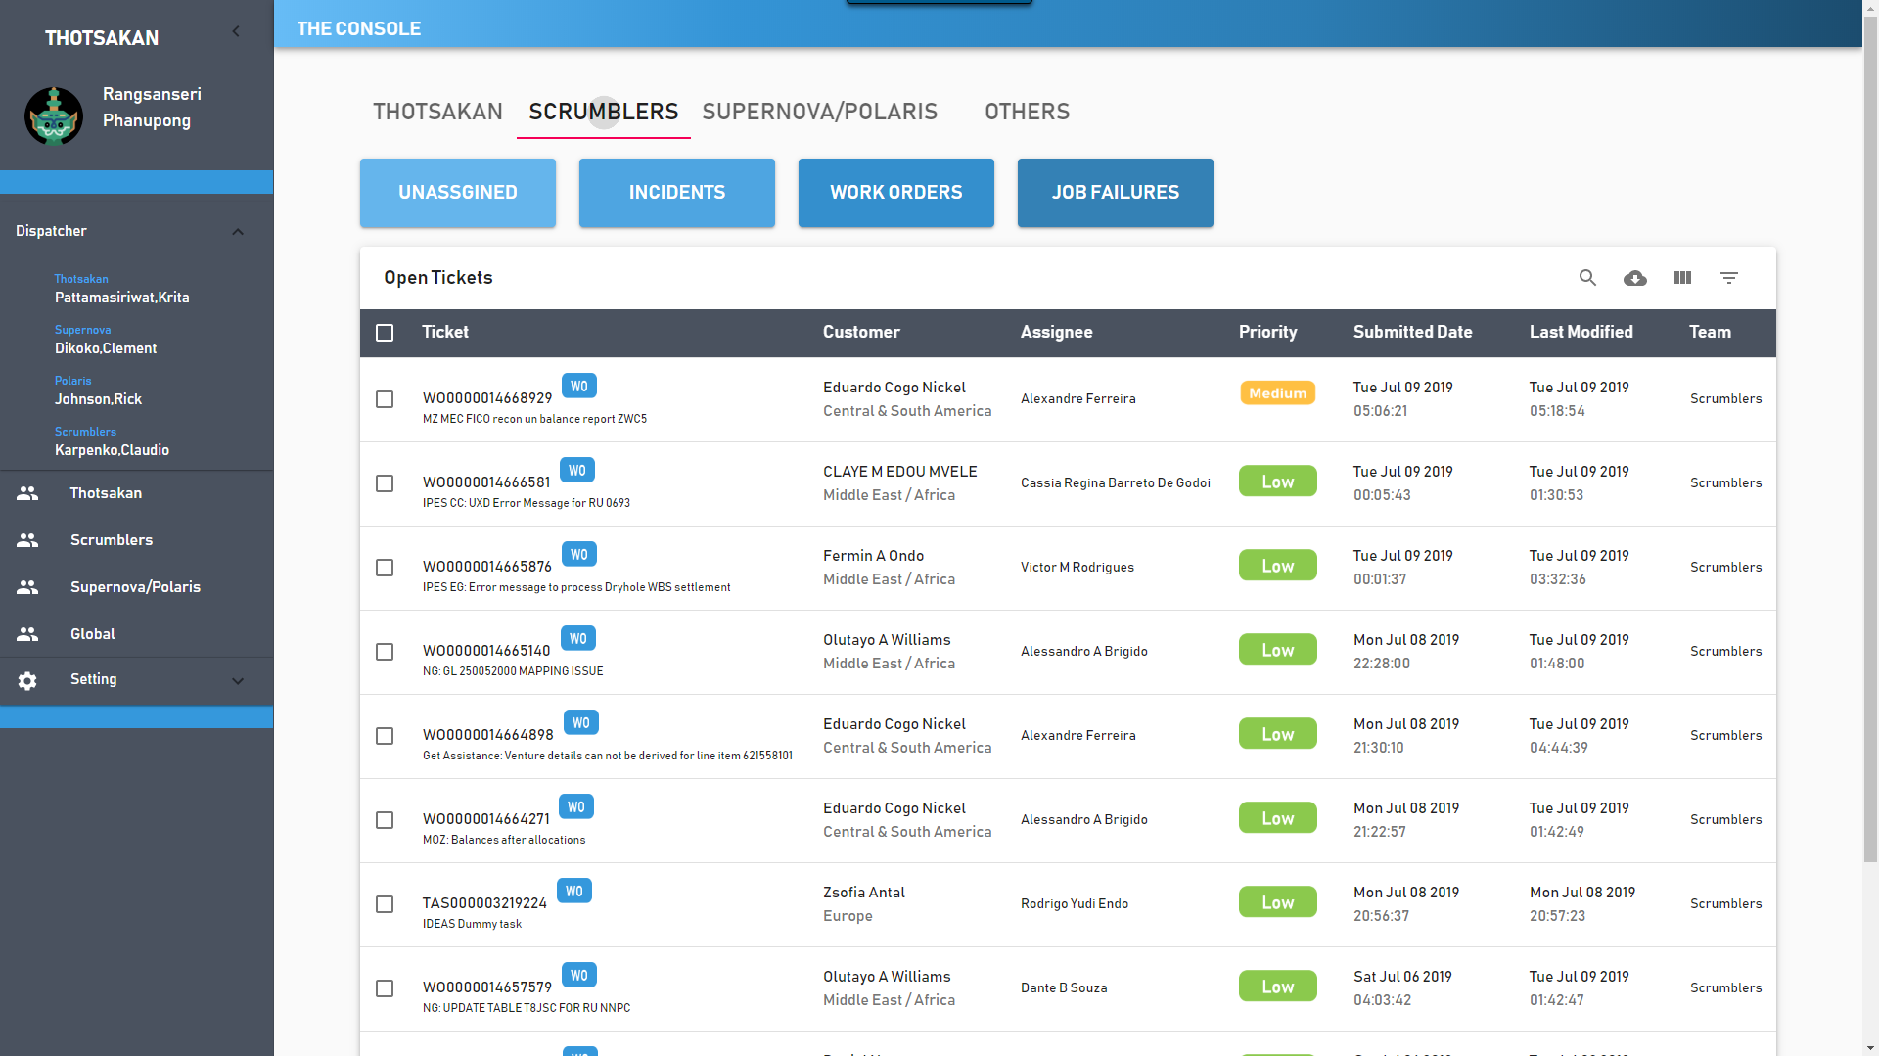
Team classification

Slide 27
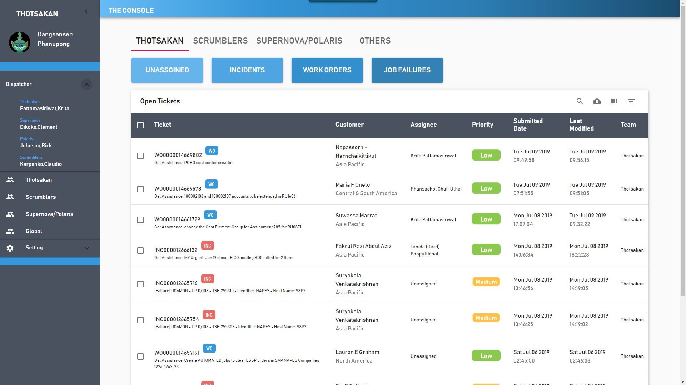
Display dispatcher

Slide 28
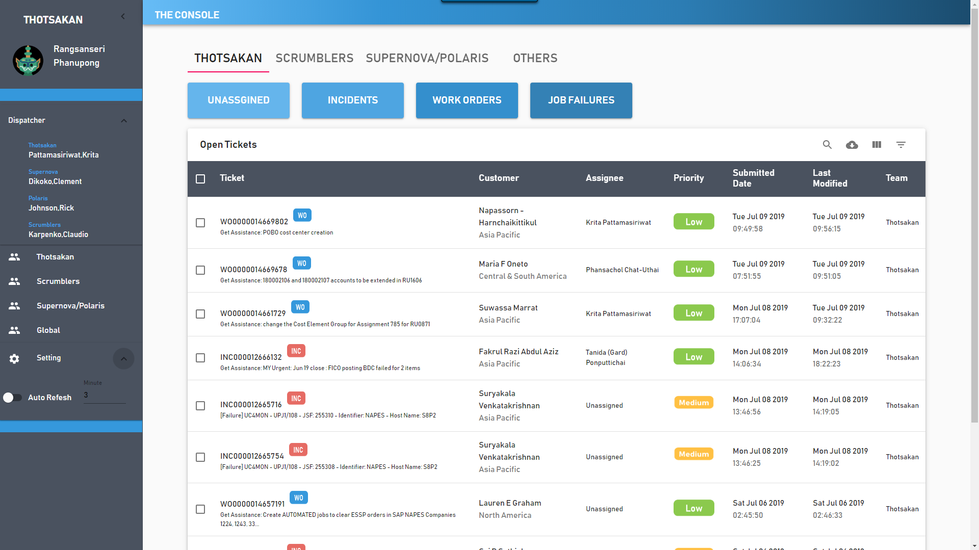
Auto refresh

Slide 29
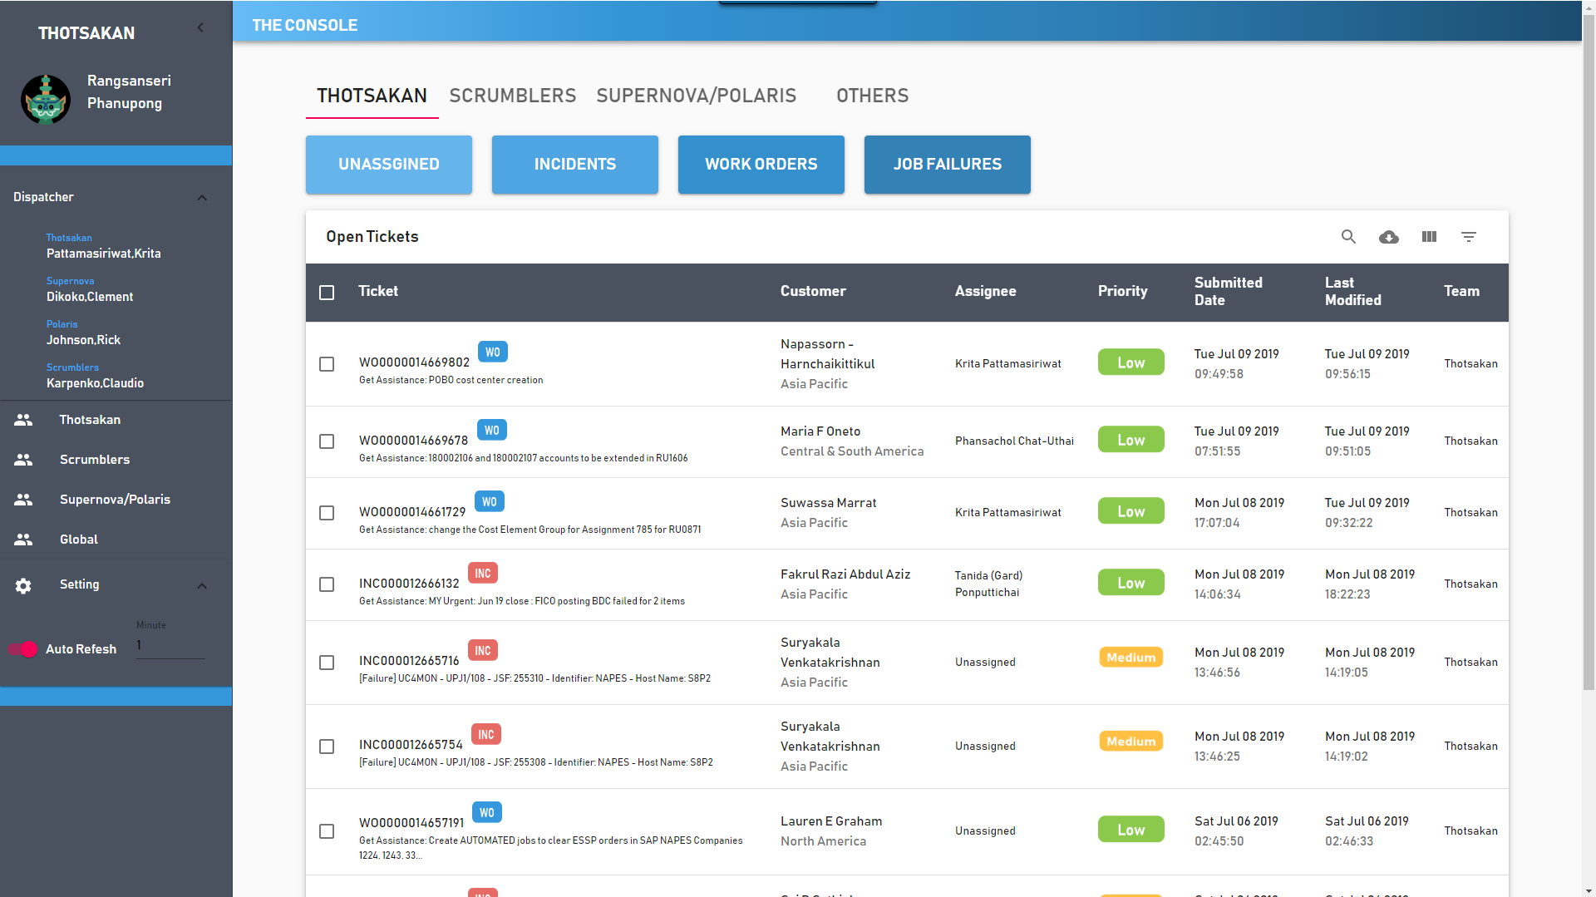
Auto refresh

Slide 30
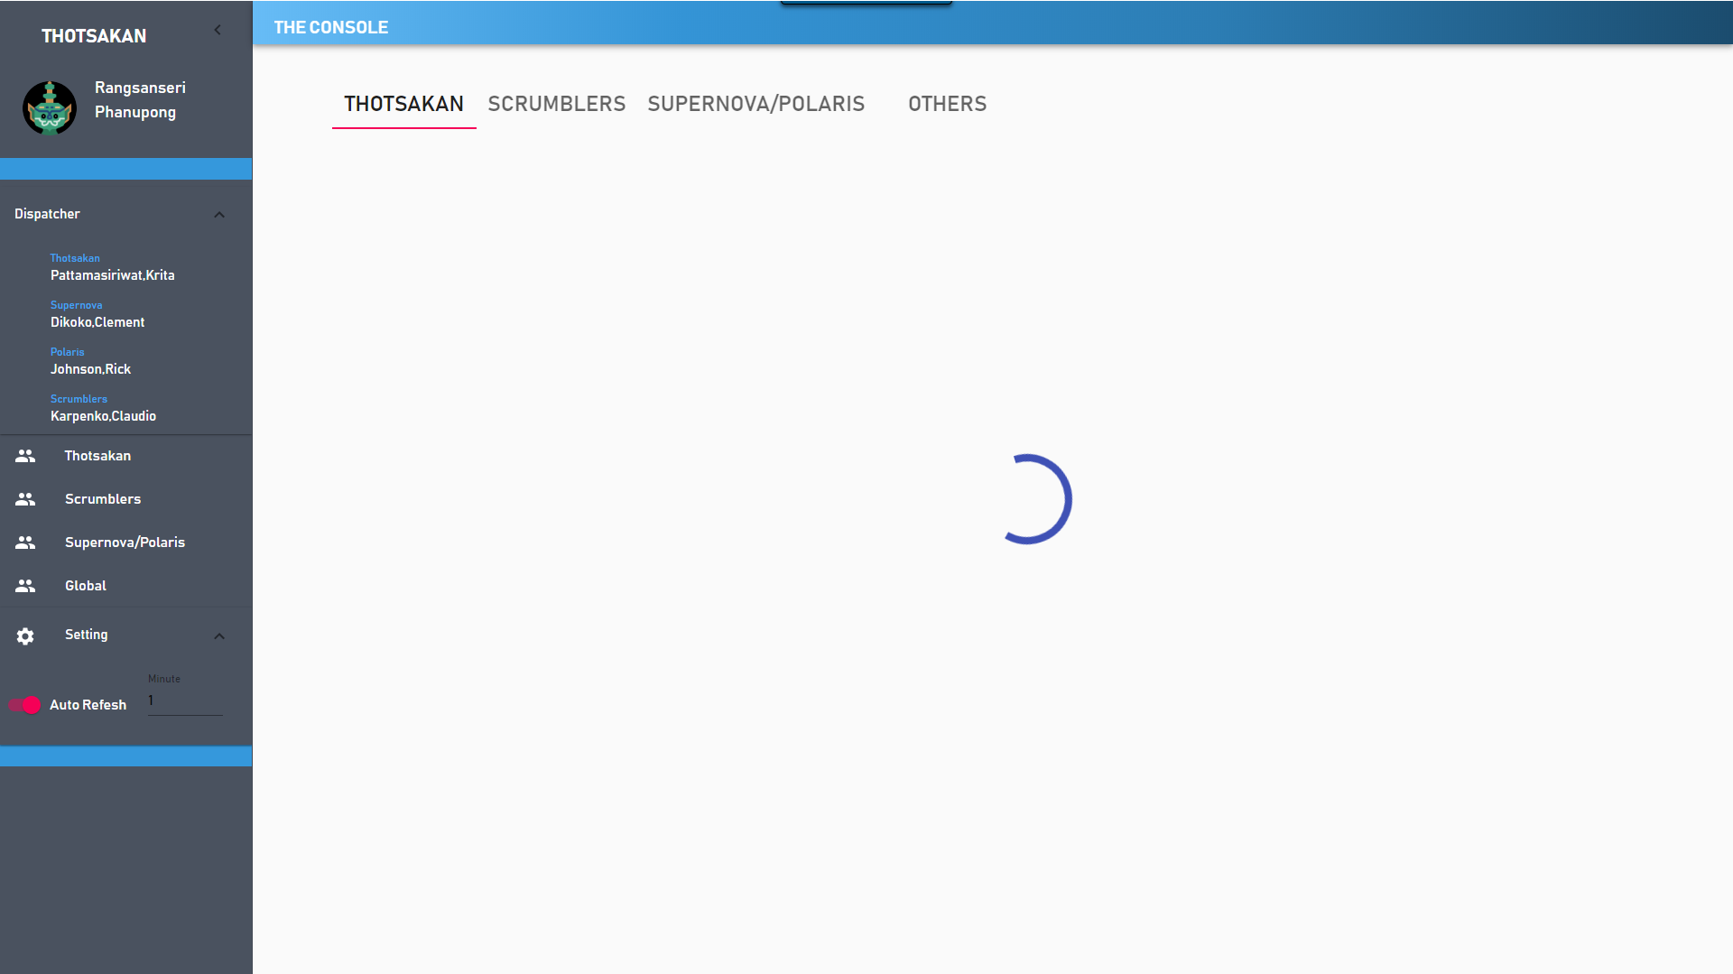
Auto refresh

Slide 31
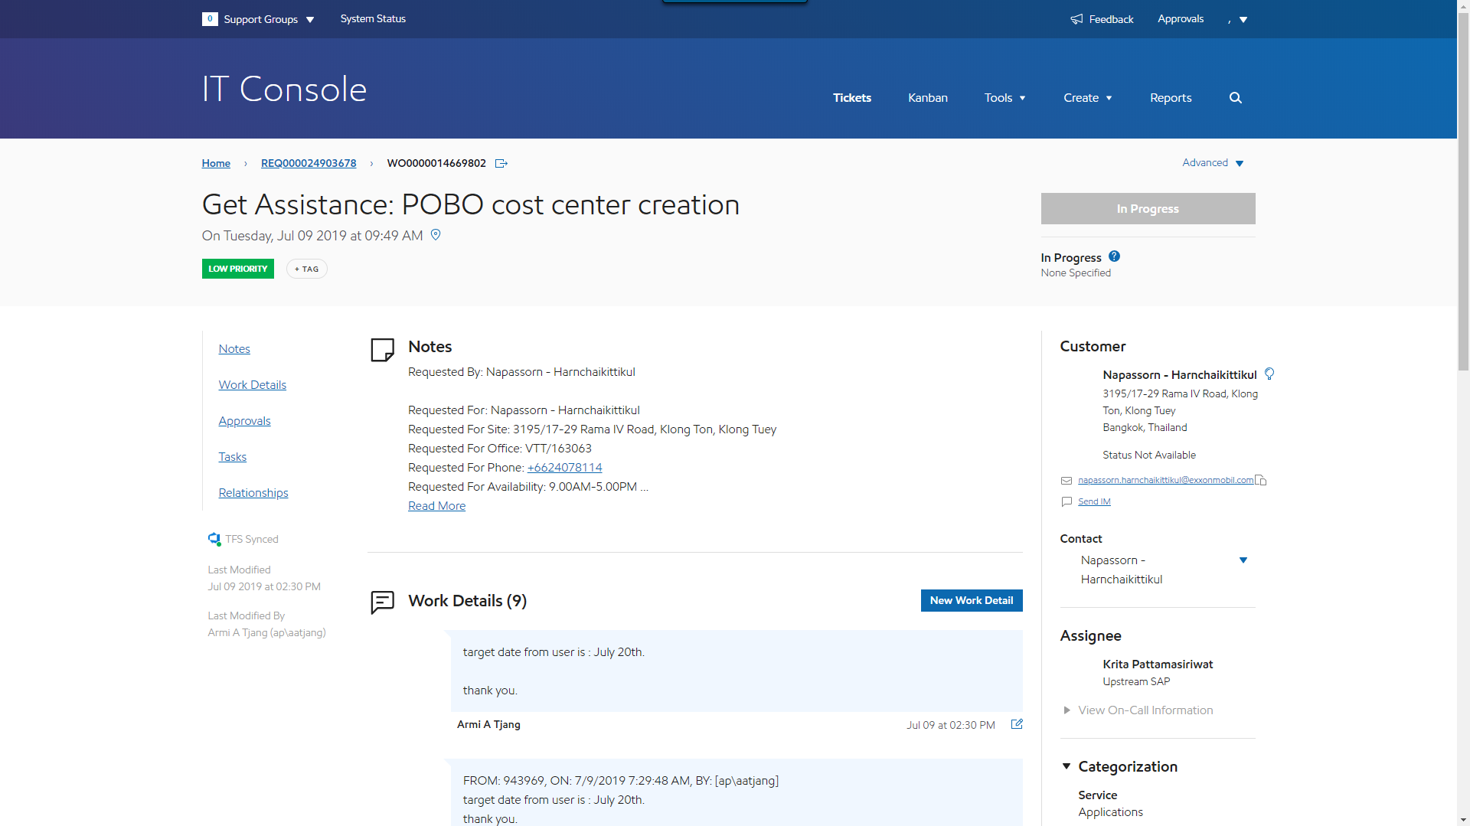
Ticket detail

Slide 32
Future work
Phase 2 (4 months)
Notification
Statistics page
ITSM’s ticket info update
Notes:
Statistics and deploy

Slide 33
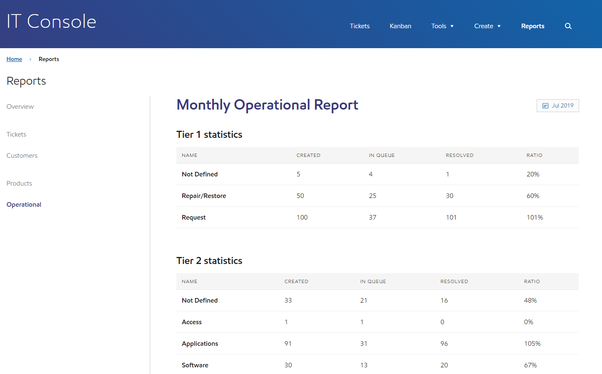
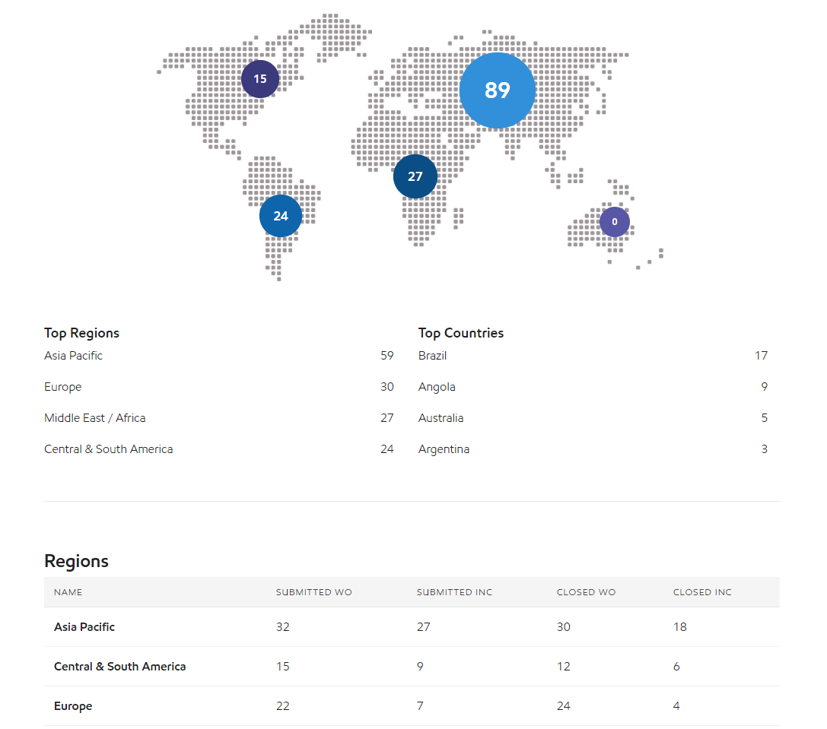
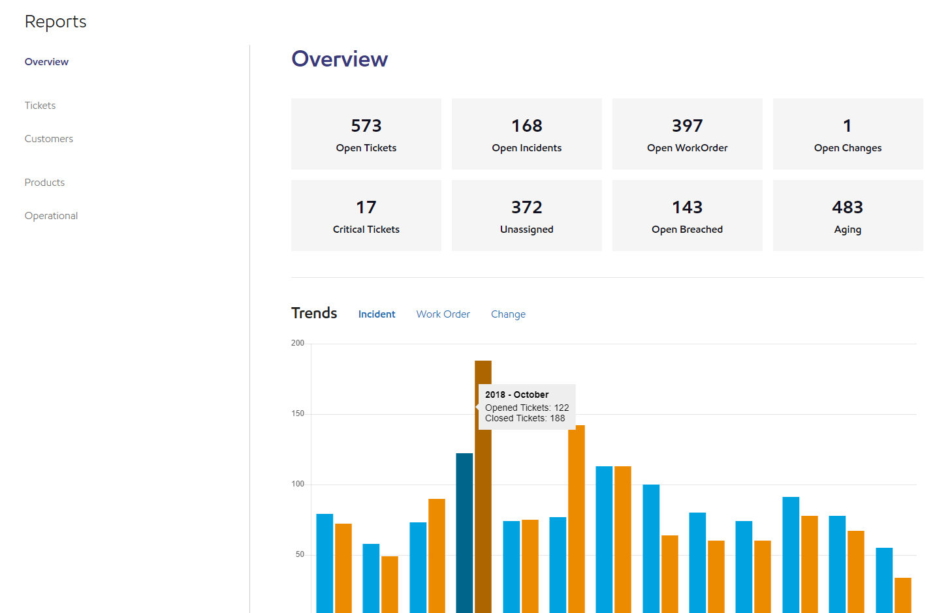
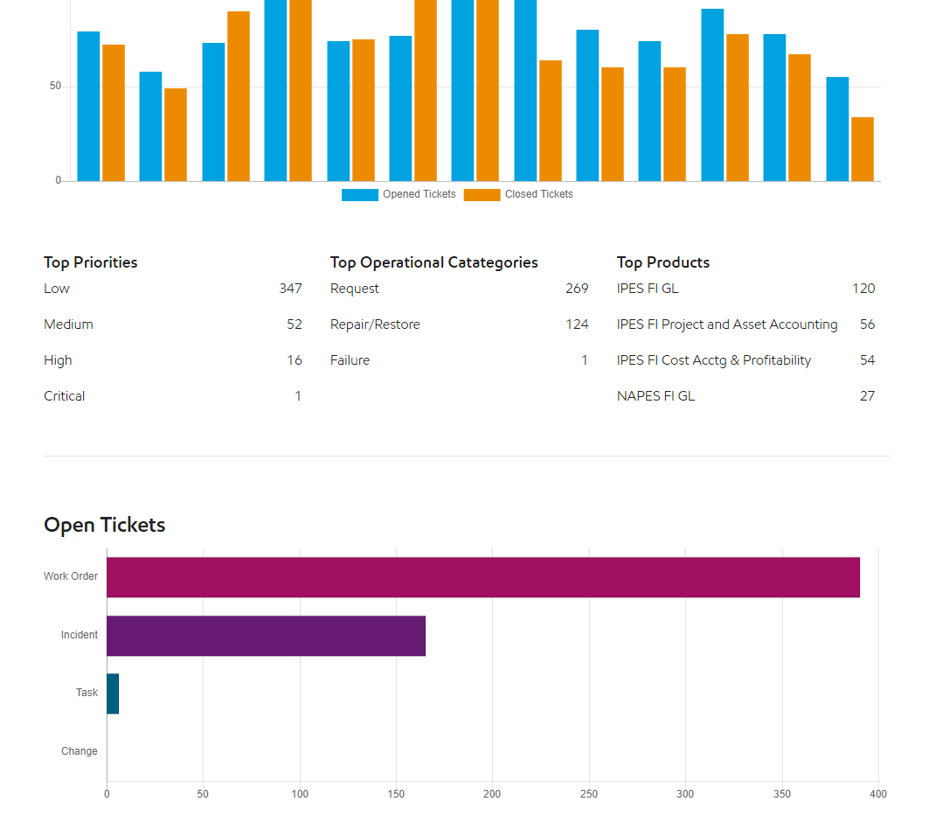

Slide 34
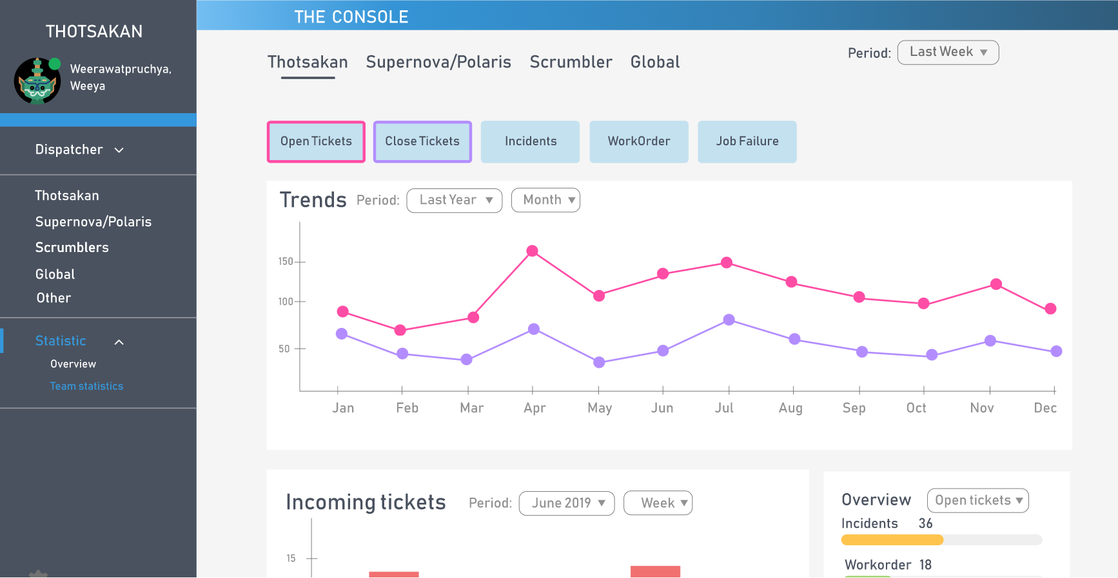
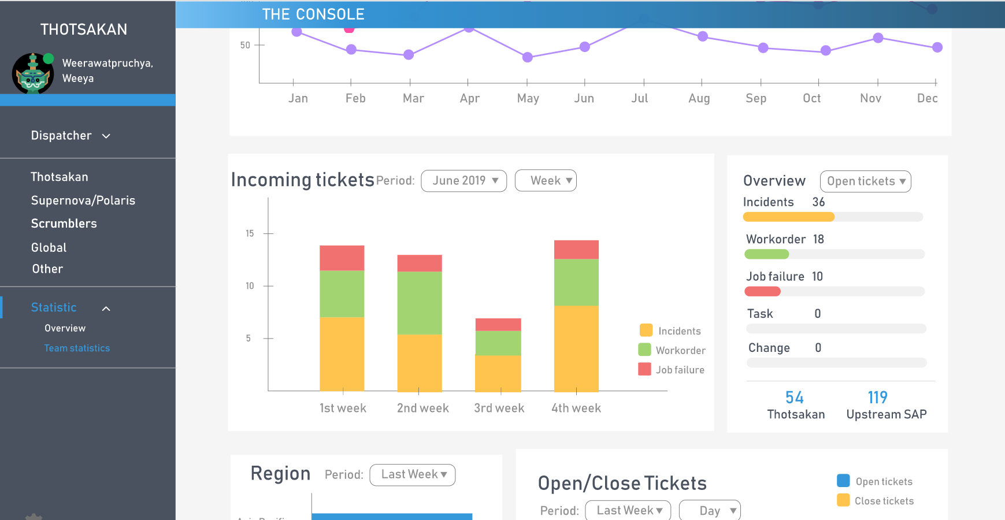
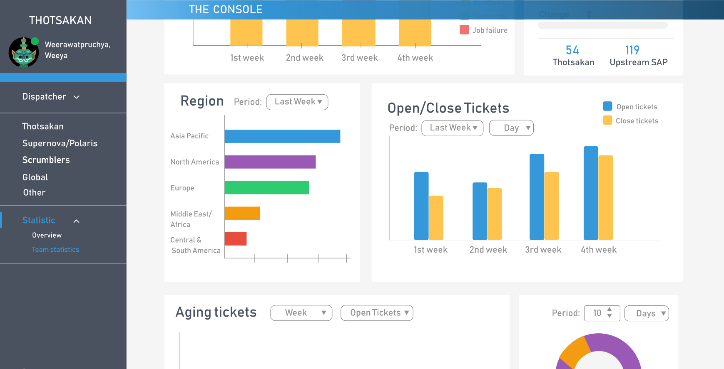
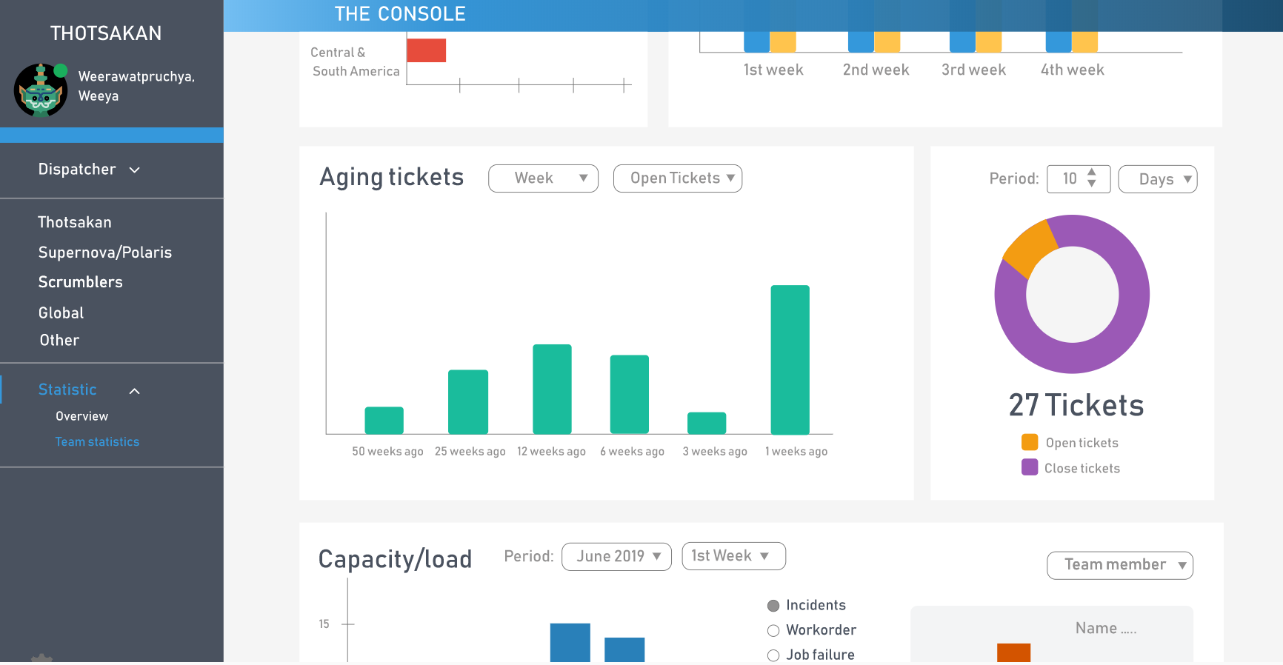

Slide 35


Benefit to team
Reduce times usage
Improve efficiency

Slide 36


Challenge
Collaborations with new friends
Adapt to project's requirement changing
Time limitation
Speak English

Slide 37
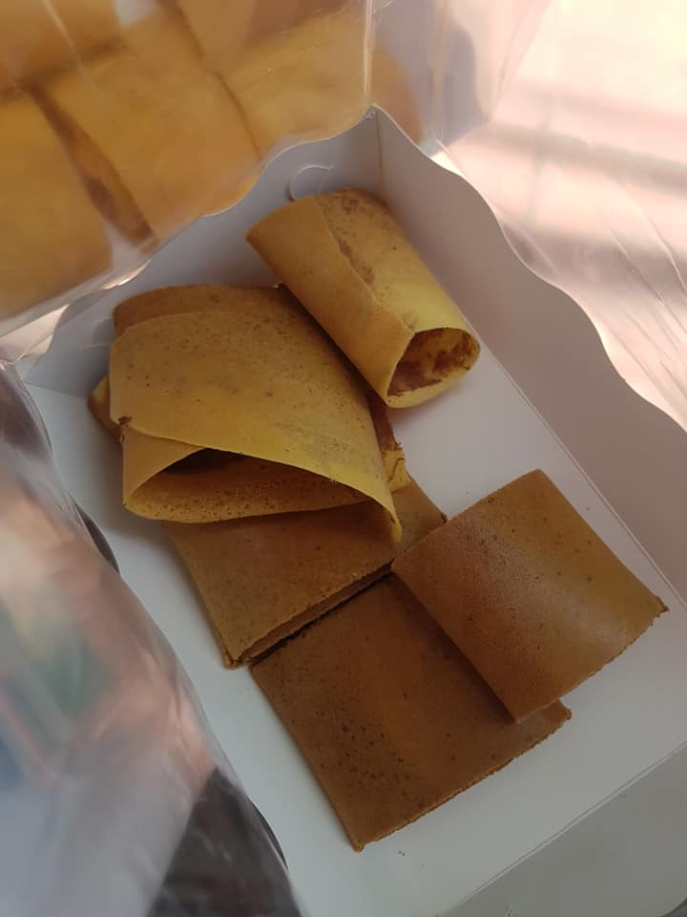
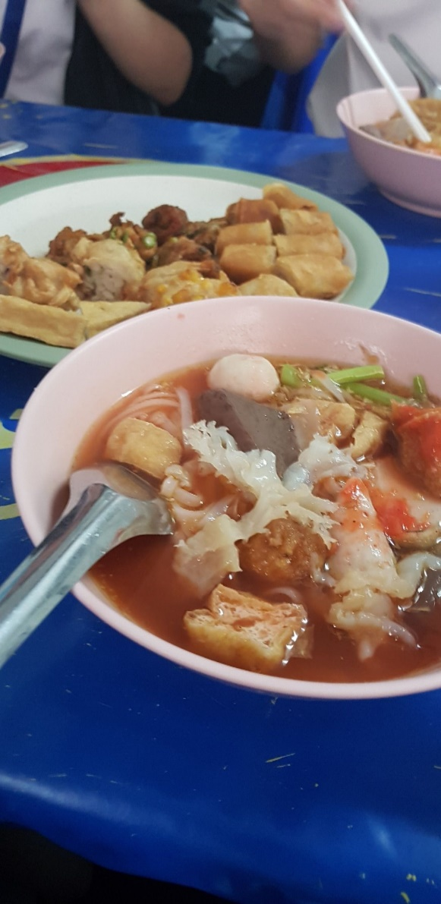


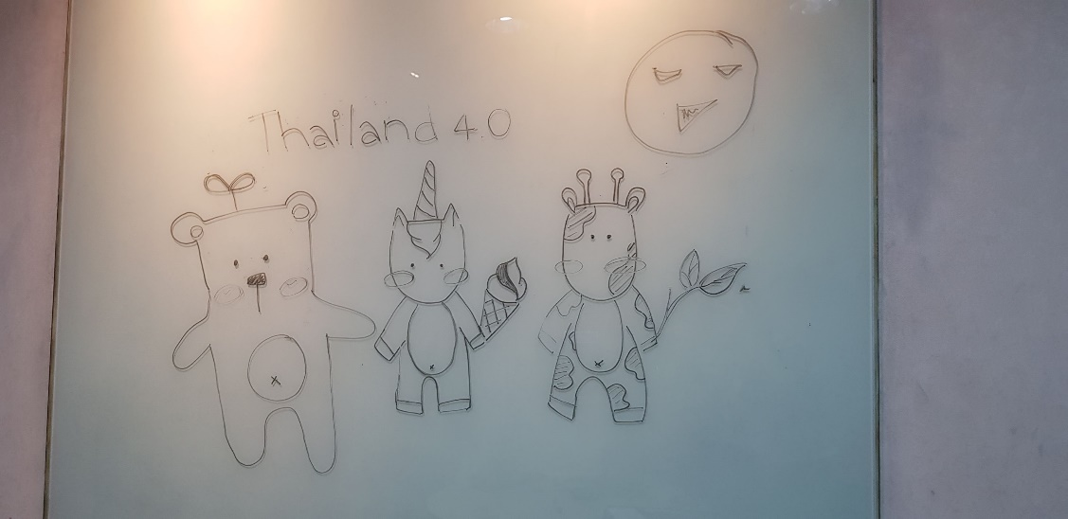
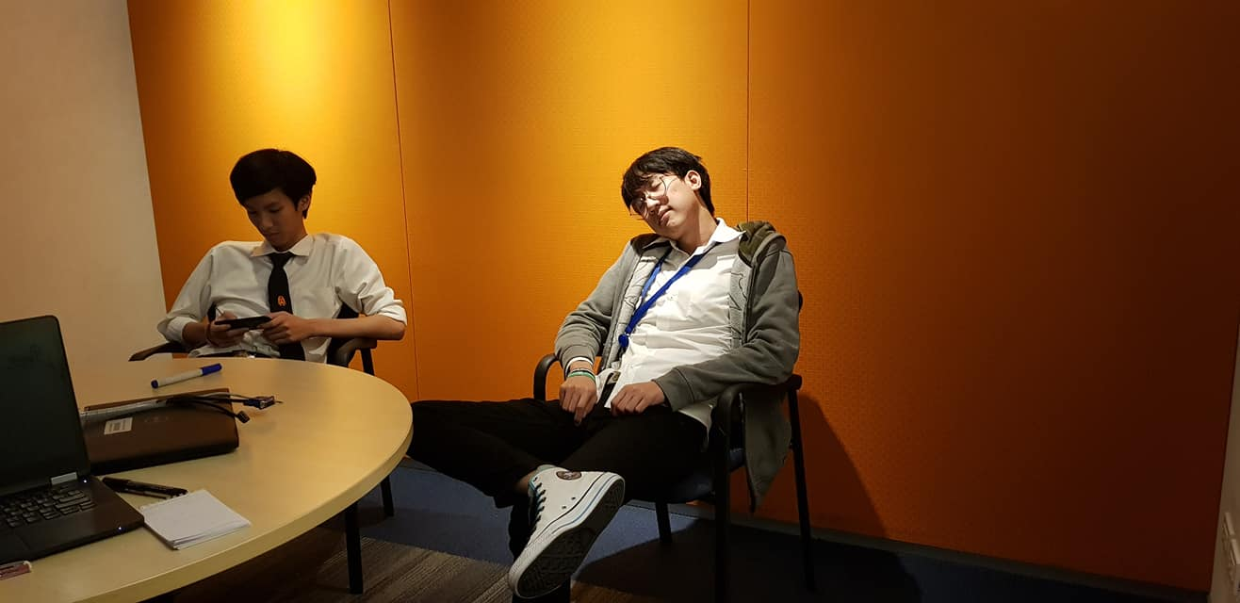

Slide 38
If you only do what you can do,
You’ll NEVER BE BETTER
Than what you are.
-Master Shifu-

Slide 39
Q & A

